Slide 1
From Cmdlet to Function – A Beginners’ Guide to PowerShell
newCodeCamp 2019

Slide 2


Mike Nelson
Solutions Architect
@nelmedia
mike@mikenelson.io
Microsoft MVP, Azure Advisor, VMware vExpert, Citrix CTA

Slide 3
Get-Content
PowerShell Basics
Functions & More
The Demo
Creating a script
Your first Function
Morphing into a Module

Slide 4
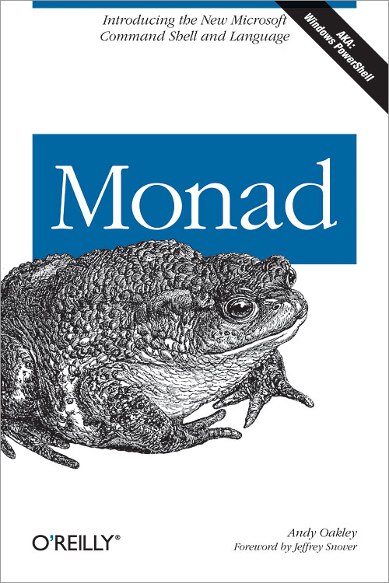
HOW IT STARTED
Jeffrey Snover, Bruce Payette, & James Truher
Project Monad in 2002
Monad Manifesto (2002)
Notes:
Monads are Leibniz’s term for the fundamental unit of existence that aggregates into compounds to implement a purpose. In this philosophy, everything is a composition of Monads. This captures what we want to achieve with composable management. See Monadology.
Cscript was early beginnings
Microsoft Shell or MSH was next.

Slide 5
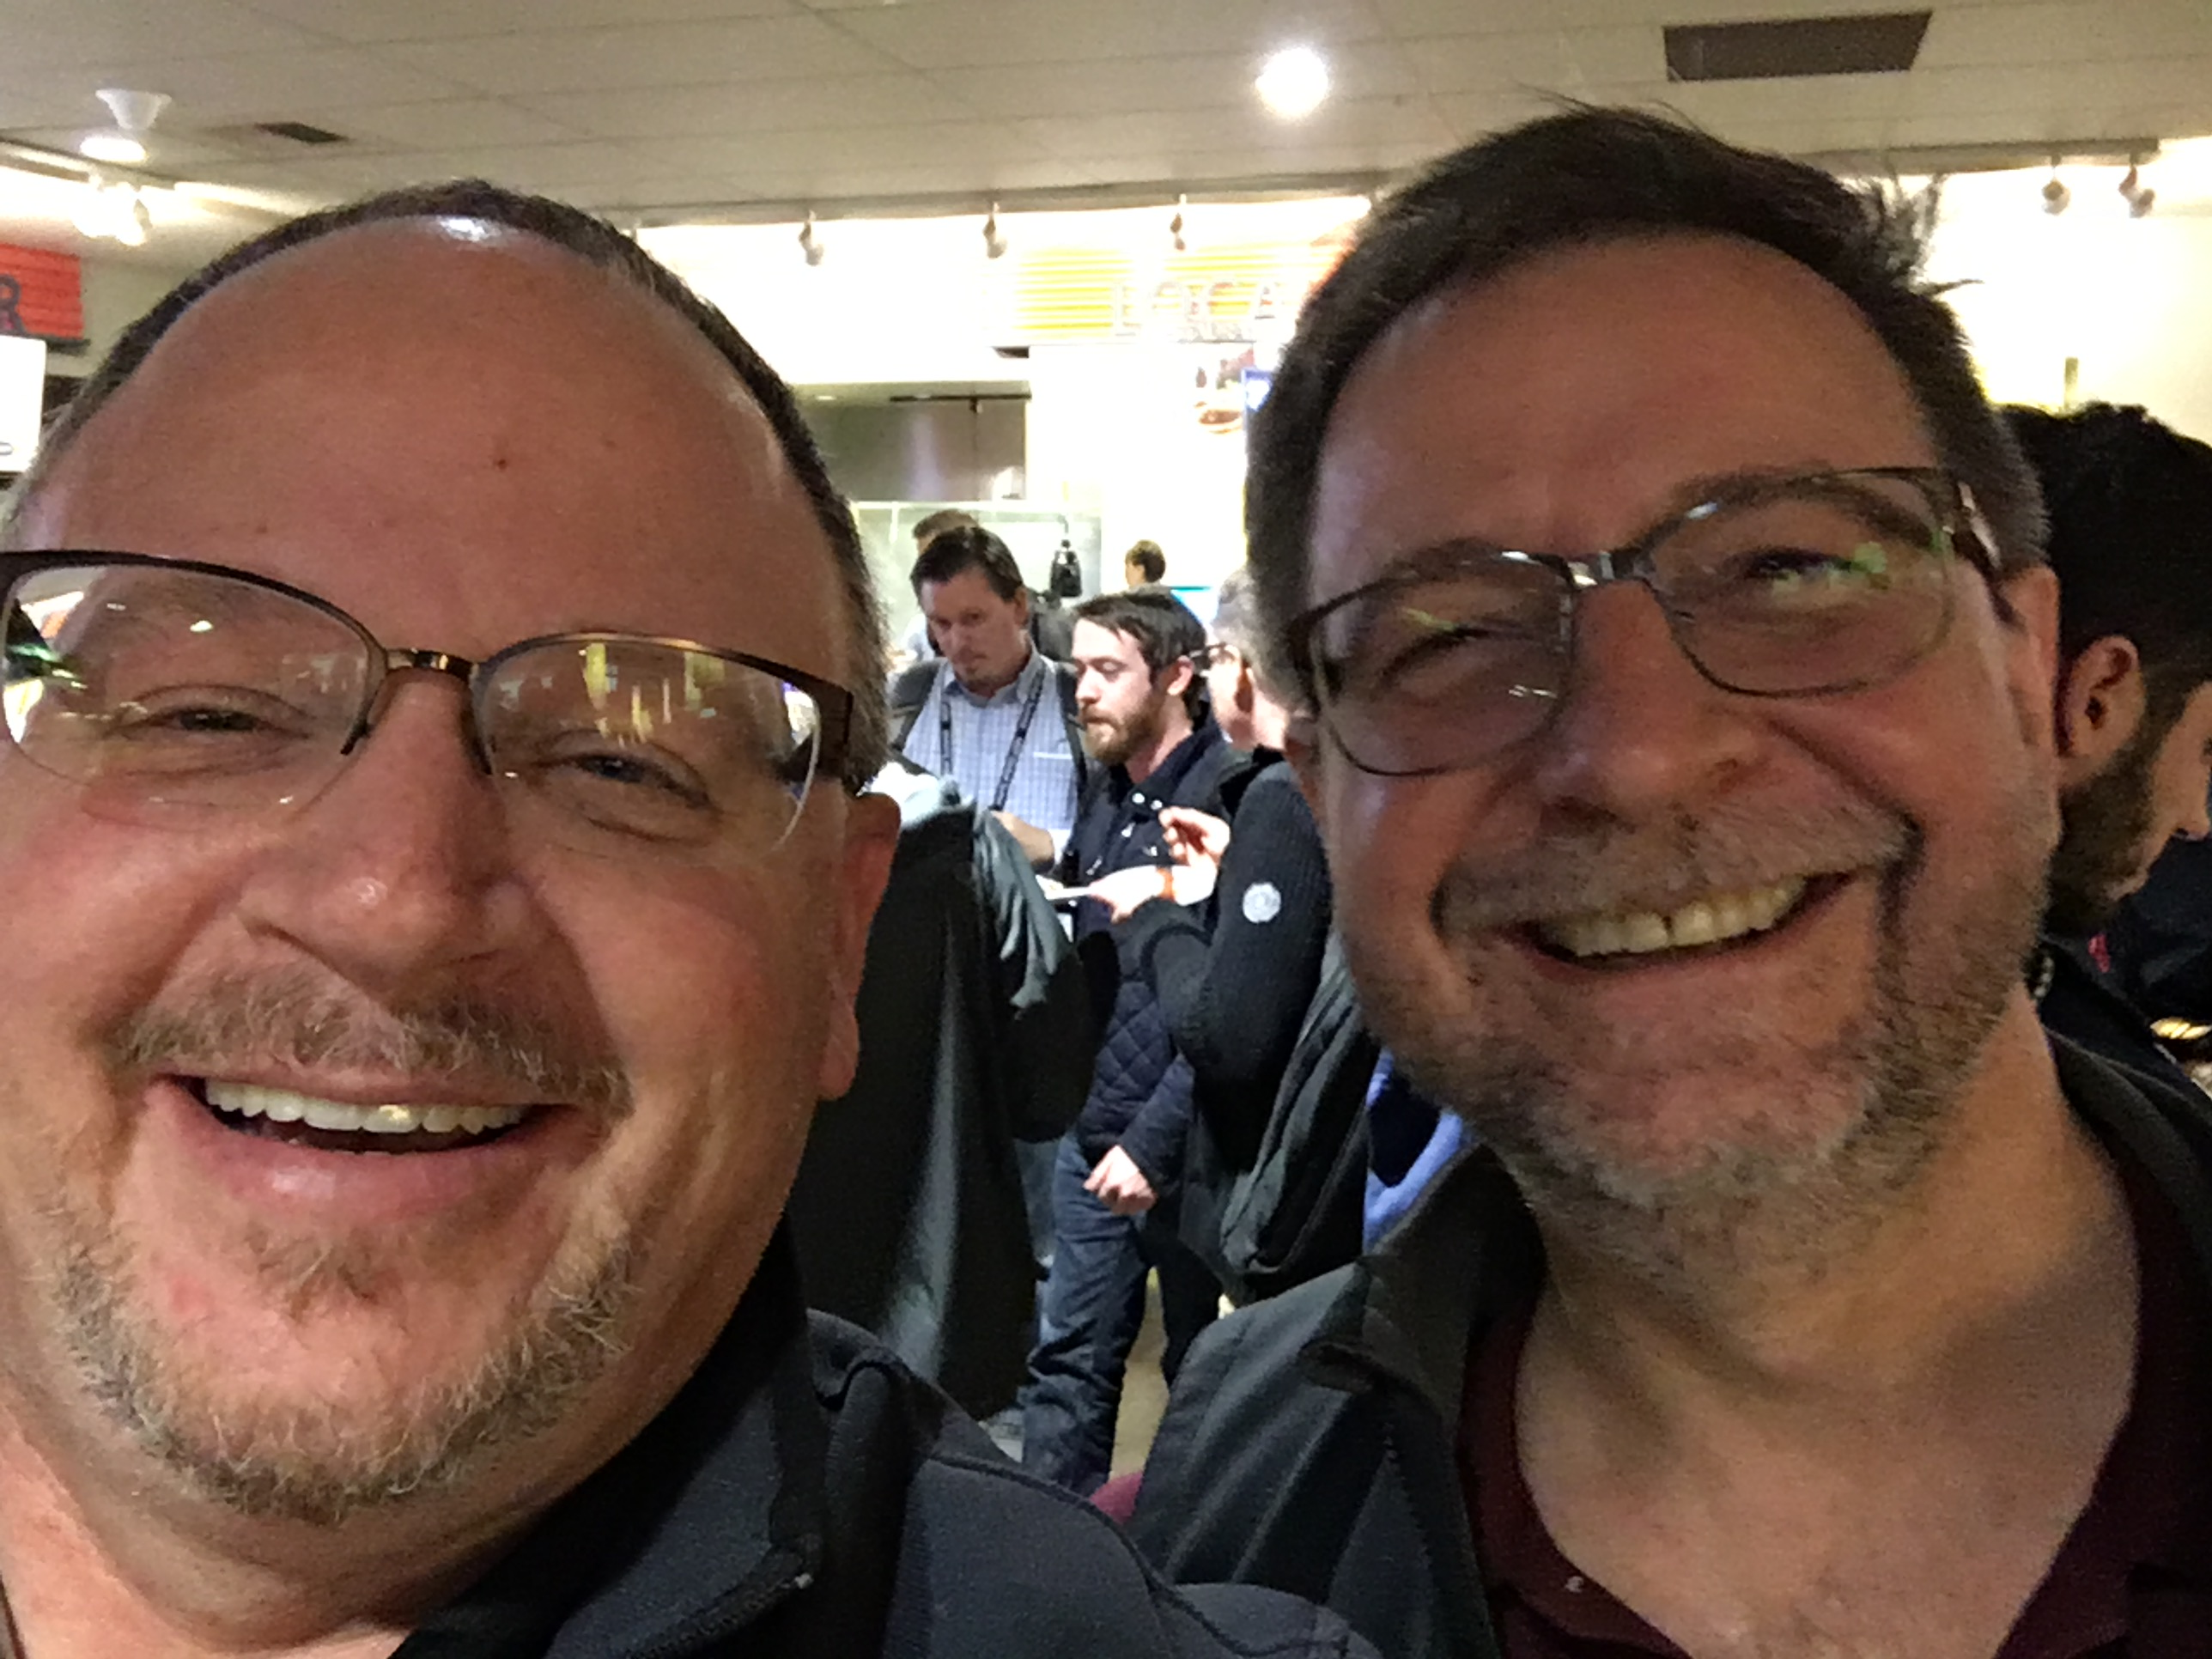
Snover Quotes
“This is rock science, not rocket science.”
“I took a demotion to create PowerShell.”
“PowerShell is a such a great product because I am a deeply flawed human being.”

Slide 6

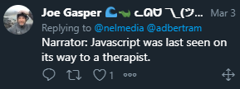
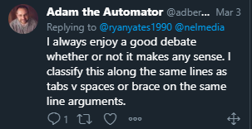
The Debate?
Is PowerShell considered a programming language?
Notes:
Garry Taylor - Yes, it meets all the definitions to be a programming language. But then, 50 Shades of Grey probably meets all the definitions to be “literature”.
I’d say it meets all the strict definitions, but not the spirit of what we mean.
I’ve got nothing in the world against PowerShell, it seems very nice, however if I met someone who described themselves as a programmer, and they declared that they wrote *only* PowerShell, I’d think they might be stretching the meaning of the word a bit.

Slide 7




VERSIONS
Coming Jan 2020!
5.1
Core
PowerShell 7
Notes:
Core will not replace 5.1 for now. 5.1 will only get fixes and security updates. Why?
Core will become PowerShell 7 (Core name removed)

Slide 8


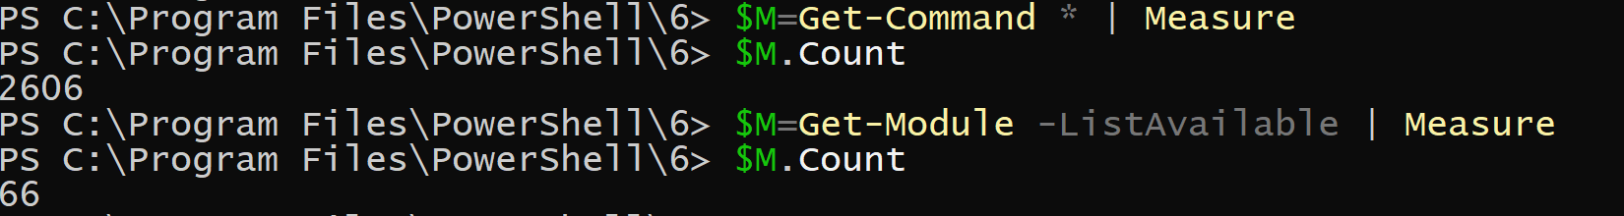

5.1
6.2.2
July 2019
7.0p6

Slide 9
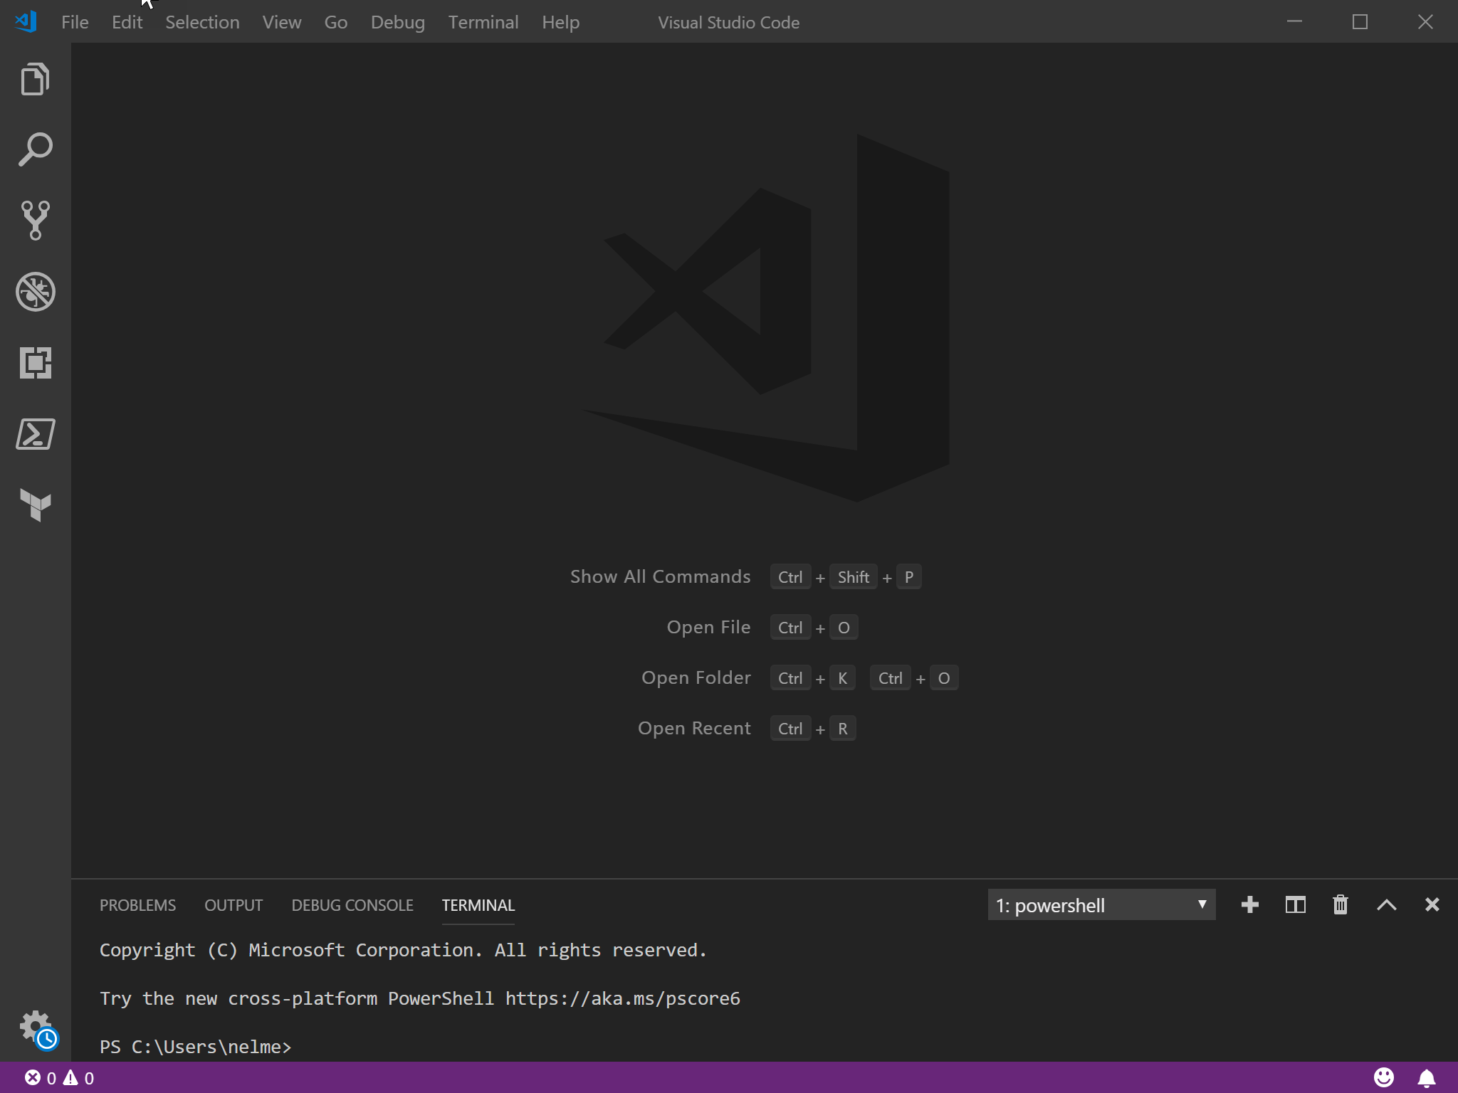
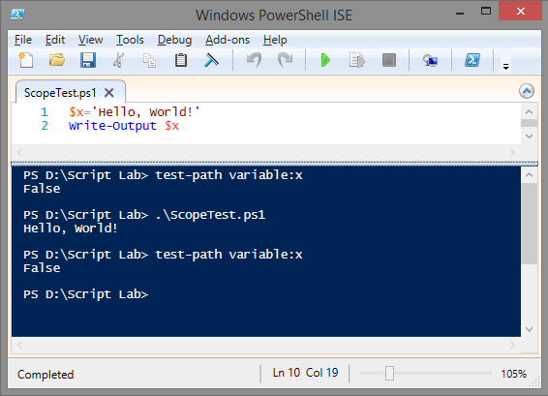
EDITORS
ISE
VSCode

Slide 10
SYNTAX
Positional Parameter
Switch Parameter
Verb
Noun
Value
Cmdlet
Named Parameter

Slide 11
4 CORE CMDLETS TO HELP LEARN
Get-Command
Get-Help
Update-Help
Get-Member
Show-Command

Slide 12
LET’S MAKE IT EASY
😉
PowerShell Gallery
Easy find, install, & update of Modules
Chocolatey
Easy updating of Core (and more)
Github search
Always give credit

Slide 13
“Create documented and reusable code, you will.”
- PowerShell Yoda

Slide 14
FUNCTION
A list of statements you define
function helloworld { Write-Host ‘Hello World!’ }
You then simply call the function
Statements then just run like you typed them
Functions can be in scripts, modules, profiles, and “called” from scripts

Slide 15
MODULE
A package of commands in a .psm1 file
PS>New-Module is one way
3 kinds
Script – psm1 files that contain any valid PowerShell code
Binary – compiled DLL’s
Dynamic – only available in memory
Manifest (optional) – .psd1 file that describes a module, syntax & requirements, & how it is to be processed
PS>New-ModuleManifest
PS>Test-ModuleManifest
When would you / should you create a module?
Notes:
When do I create a PowerShell module?
You can easily decide whether to create a module by answering the following questions while writing a script:
Will the code I'm writing need to be used more than once?
Does this code essentially manage a single object or entity?
As I write this code, do I find that I'm breaking it apart into functions because it's getting too complex to be in a single script?
Do I need to share the code with others?
If you answered yes to at least three of these four questions, it's a good bet you should be writing a module instead of a PS1 script.
Module Manifests contain verbose information as well as any specifying of extra or necessary files for the module, such as XML or JSON.

Slide 16
PIPELINE
Connecting commands together
PS>Get-Process | Out-Host -Verbose
Reduce the effort of writing long, complex commands
Can utilize pipeline variables ( $_ or $PSItem )
Commonly used in “one-liners”

Slide 17
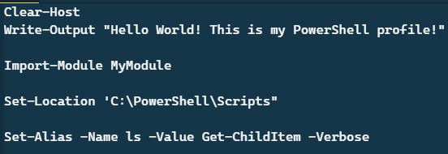
PROFILES
A script that runs when PowerShell starts.
$profile

Slide 18
Let’s Create a Module!

Slide 19
What are we going to do?
Start by seeing some basics
Create a script that runs an alarm clock
Turn that script into a function
Take that function & create a module
But before we get to that…

Slide 20

THANKS!
Any questions?
You can find me at
@nelmedia
mike@mikenelson.io

